Slide 1

Forschungspraktikum IT-Sicherheit SS 2023
AI & Covid
Supervisor: Prof. Dr. Andreas Mauthe (Institut für Wirtschafts- und Verwaltungsinformatik, FG IT Security and Data Security)
Second Supervisor: Mike Reuther (Institut für Wirtschafts- und Verwaltungsinformatik, FG IT Security and Data Security)

Slide 2
Team-Members
Abdullah Md Humayun Kabir
Tanzina Mollah
Shayekh Mohiuddin Ahmed Navid
M Rashedul Hasnat
Jesmin Aktar Mousumy
Saborni Shernaj Binte Elahi
Jahid Hasan Polash
Kazi Mostafa Shahriar
Adnan K M Wahid
Kamrun Nahar
Bosede Osayande
Parminder Kaur Grewal
https://www.hs-koblenz.de/en/rmc/international-office/projects-and-events/translate-to-english-koalas

Slide 3
Main Agenda
Addressing the research question
Project Roadmap Overview
Our Progress
Our Timeline of Goal to Complete
https://www.hs-koblenz.de/en/rmc/international-office/projects-and-events/translate-to-english-koalas

Slide 4
Research Question
3 Key Points
Poisonous data
Statistical Analysis
Mitigation Strategies

Slide 5
Research Question
How can we investigate the vulnerabilities of AI models in predicting COVID outcomes by identifying potential presence of poisonous data using statistical analysis, and what mitigation strategies can be proposed to improve model robustness?

Slide 6
Project Structure
Part 1: Building a Machine Learning Model
Part 2: Attacking the model that we have built to find vulnerabilities.

Slide 7

Working Steps
ML Model
1
Make Scraper to get Data
2
Statistical Findings
3
Merge Data Individual Data
4
Clustering Analysis for all cities
Correlations
Distributions
Descriptive Statistics
Build Machine Learning Models
1. Decision Trees/SVM and Others
2. Time Series Forecasting
5
Statistical Findings of the ML Model
6
Explanation of the Choice of Models
7

Slide 8
Working Steps(Till Date)
Attack
1
Fast Gradient Sign Method(FGSM) and some algorithms(yet to select on the basis of our work progress)
2
Attacking the Model( 3 or 4 ways)
3
4
Post attack Analysis
Why use the above methods to attack the model ?

Slide 9

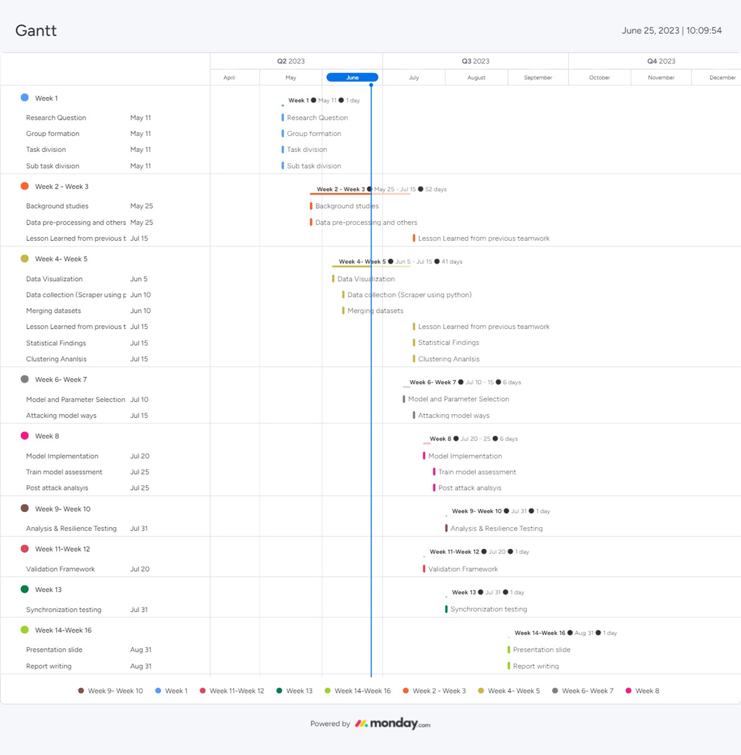
Gantt Chart
Monday Work Management Tool

Slide 10

Questions

Slide 11


